Slide 1
Improving Simulation Model Calibration for Cost-Effectiveness Analysis via Bayesian Methods Progress Report 2023

Slide 2
Background: Cost-Effectiveness Analysis
New healthcare strategies (for disease screening, diagnosis, treatment, …) need to be evaluated.
From a healthcare point of view (e.g. life expectancy), but also economically (e.g. €).
We use simulation models to project estimated outcomes for these strategies.
These outcomes are compared to decide which strategies are worthwhile.

Slide 3
Background: Cost-Effectiveness Analysis
Probabilities
(e.g .developing cancer, death, recurrence, …)
Simulation model
Average life expectancy
Average yearly cost per person
Test sensitivities & specificities
Disease incidence
Costs
Disease mortality
…
…

Slide 4
Background: Cost-Effectiveness Analysis
Parameters (e.g. probabilities, sensitivities, specificities, costs, ...)
Strategy 1
Output
Strategy 2
Output
Comparison and analysis
…
Strategy n
Output

Slide 5
Background: Calibration
Parameters for these simulations are obtained from scientific literature, clinical studies, …
Uncertainty in the simulation results
We may have knowledge about the outcomes for the current practice.
We can reduce uncertainty in some parameters by changing their values so the observed and expected outputs for the current practice are as similar as possible (calibration).
The calibrated parameters will reduce the uncertainty when simulating the rest of strategies.

Slide 6
Background: Calibration
Parameters
Current
practice
Simulation output ≈ Expected output
Strategy 1
Simulation output
Strategy 2
Simulation output
…
Strategy n
Simulation output

Slide 7
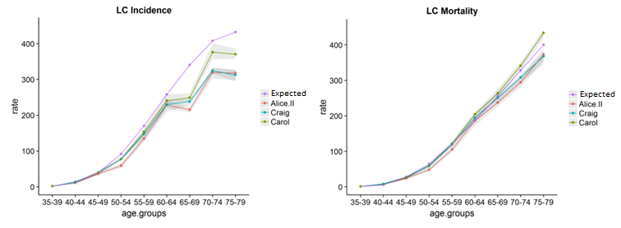
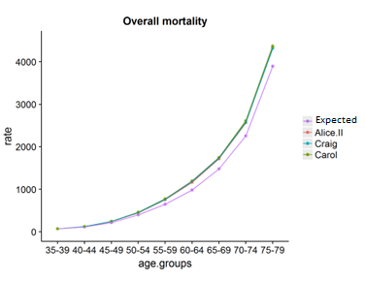
Background: Calibration

Slide 8
Background: Calibration
Model calibration is an optimization problem with some known characteristics:
We know the logic between inputs and outputs
Can be computationally expensive
Can be high-dimensional
Can be highly-constrained
Traditional methods used (Nelder-Mead, Simulated Annealing, ...) need a lot of simulations and can take a long time, with no guarantee of finding valid solutions.

Slide 9
Research objectives
The goal of the thesis is to adapt a Bayesian Optimization methodology to efficiently optimize simulation models for Cost-Effectiveness Analysis

Slide 10
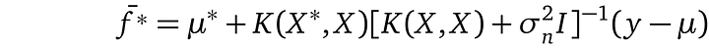
State of the art
Bayesian optimization (BO) is a state-of-the-art optimization method for expensive systems such as hyperparameter tuning for machine learning models.
BO uses a surrogate model to represent the system, such as Gaussian Processes.
Gaussian Process Regression has scaling issues with the number of observations (n).
n x n matrix

Slide 11
State of the art
Bayesian optimization (BO) is a state-of-the-art optimization method for expensive systems such as hyperparameter tuning for machine learning models.
Several improvements are available:
Additive kernels (Duvenaud 2011, Lu 2022)
Constraint modeling (Gardner 2014)
Input prior specification ()

Slide 12
Research Methodology
Literature review
Improvements for Bayesian Optimization methodology
Analysis
Structural properties of simulation models
Design & development
Adapting improved techniques to our simulation models
Evaluation
Tests in simulation models used in published biomedical research
Dissemination

Slide 13
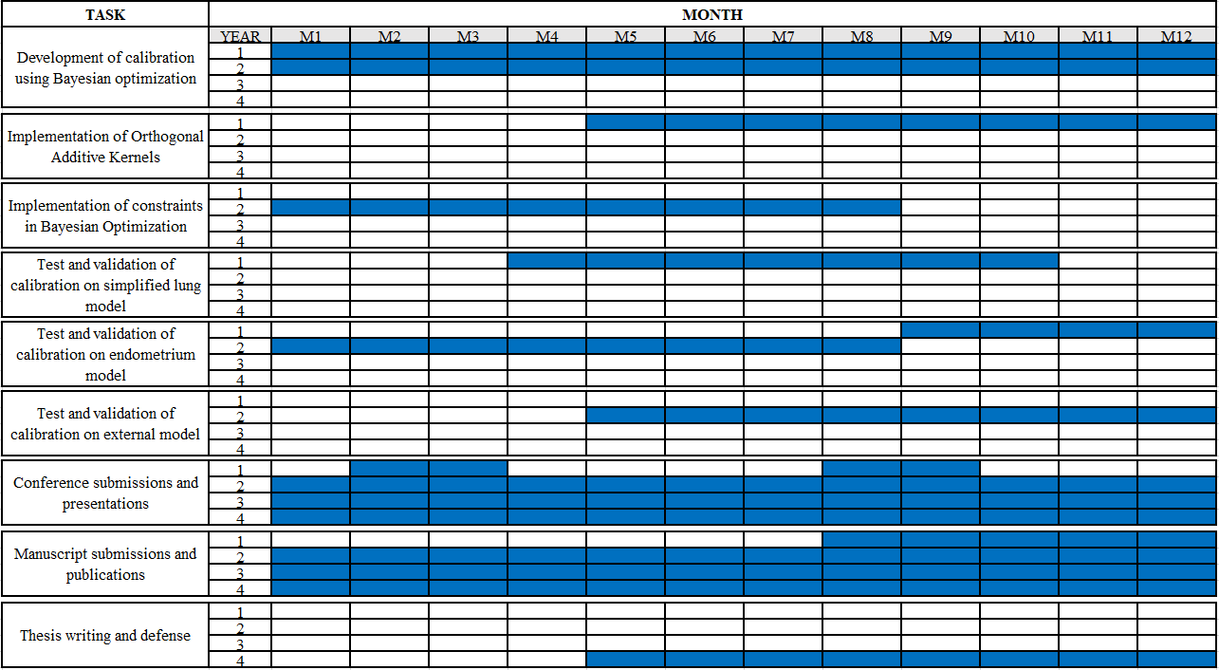
Work plan

Slide 14
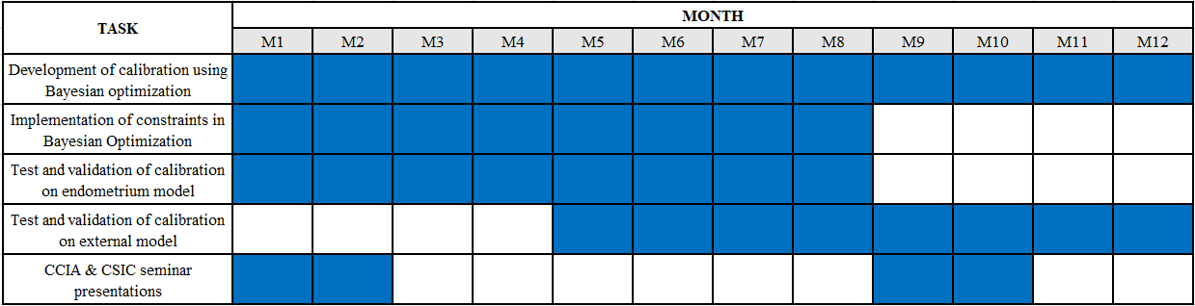
Detailed work plan for the current academic course (2nd year)

Slide 15
Publications
Gómez-Guillén D, Montoliu S, Arcos JL, Cerquides J, Diaz M. Bayesian optimization for calibration of simulation models to perform cost-effectiveness analysis. PhD Day 2022. IDIBELL. Spain. [Poster session]
Gómez-Guillén D, Diaz M, Arcos JL, Cerquides J. (2023) Bayesian optimization with additive kernels for the calibration of simulation models to perform cost-effectiveness analysis. CCIA 2023 [Submitted]

Slide 16
Conclusions
Cost-effectiveness analysis is a fundamental tool in biomedical research.
Simulation models need to be calibrated to ensure coherent results.
Calibration can be very time consuming and produce incoherent parameters.
Bayesian Optimization can help calibrate simulation models more efficiently and obtain better parameters.

